Slide 1
Scholarship Overview
We empower Florida students with personalized
PreK3-12 education scholarships.
Notes:
Good Afternoon my name is Carla Hernandez and I am one of the regional managers for Miami Dade county. I am joined by my friend and colleague Dina Damus and I am going to let her introduce herself.

Slide 2
Scholarship Updates
Notes:
Paula

Slide 3
2023-24 Scholarship Updates
FES-EO and FTC
Students on Applications: 388,408
Total Students Awarded: 303,277
Total Students Enrolled: 267,650
PEP
2023-24 20K Students
2024-25 60K Students
FES-UA
Students on Applications: 105,552
Total Students Awarded: 96,549
Notes:
Ronda/Paula
Please add the numbers

Slide 4
2024-25 Scholarship Updates
FES-EO and FTC
Students on Applications: 205,000
FES-UA
Students on Application: 64,000
Notes:
Ronda/Paula
Please add the numbers

Slide 5
Legislative Updates
Family Empowerment Scholarship for Educational Options (FES-EO), Florida Tax Credit Scholarship (FTC), and Family Empowerment Scholarship for Unique Abilities (FES-UA):
• Allow active-duty military members who have permanent change of station orders to Florida to apply for scholarships before they have a Florida address.
• Prohibit families from applying for multiple scholarships for the same student at the same time.
• Require, for RENEWAL FES-EO and FES-UA students, the Florida Department of Education (FLDOE) to release funds to scholarship funding organizations (SFOs) no later than Aug. 1, Nov. 1, Feb. 1, and April 1.
• Require, for NEW FES-EO and FES-UA students, the FLDOE to release funds to SFOs no later than Sept. 1, Nov. 1, Feb. 1, and April 1.
• Require SFOs to release payments for full-time tuition and fees within 7 business days after approval by the parent and the private school.
• Require parents to approve EACH quarterly payment.

Slide 6
Legislative Updates
Hope, and New Worlds Scholarships:
• Merge the Hope Scholarship Program with the FES-EO and FTC scholarship programs.
• Direct the eligible financial contributions to the FTC scholarship program.
• Allow students with bullying incidents documented by their public schools to qualify for FES-EO or FTC scholarships. New Worlds Scholarship Accounts
• Expand eligibility for the New Worlds Scholarship Program to Voluntary Prekindergarten students with substantial deficiencies in early literacy and/or math skills, based on their most recent progress monitoring results.
• Increase scholarships from $500 to $1200 per student.
• Parents/guardians will use Step Up For Students direct-pay platforms to use their ESA funds beginning in the '24-25 school year.

Slide 7
Legislative Updates
General Awareness
• Religious virtual providers can now apply with the state to become an approved virtual instruction program provider.
• Private schools can use certain facilities without specific zoning or land use requirements, provided they meet health, safety, and welfare laws.

Slide 9
School Actions for 2024-25 School Year
Schools will take 2024-25 actions in EMA during next month, including setting up their tuition & fees and enrolling students.
You can begin collecting Award IDs now, as you will need these again for enrollment.
Parents will also have the option to print their ID in the coming weeks.
With the new DOE funding timelines, it’s important to submit T&F in a timely manner and complete enrollments once approved.
More to come soon!

Slide 12
Funding Timelines – Q4
Student Enrollment Deadline: March 1, 2024. This list is sent to the FLDOE by the SFO.
FLDOE send funds to SFO: April 1, 2024.
SFO reconciles and sends funds to individual student accounts within 14 business days of receipt of funds.
Survey of EO parents to be sure they are still in the private school.
Once student is Funded, an Invoice is created and shows for the school in EMA for approval.
Q4 Payments should be made to schools between April 22nd - May 6th.
SUFS pays weekly. Approved Invoices by Friday will receive funds by following Friday.
Payment takes 3-5 days for ACH transfer once initiated.
Payment deposited to schools and providers on a weekly basis.
Notes:
Paula

Slide 13
YouTube Links for School Providers
Navigating the Service Marketplace as a School Provider-
Description: This informational webinar reviews the steps and process for schools to serve as a provider of services in EMA
FES-UA Pre-K Tuition and Fees
Description: This video is specifically created for schools catering to FES-UA preschoolers who need to pay for tuition and fees to ensure their readiness for school. This applies only to those approved as a Voluntary Prekindergarten Education (VPK) provider or county school readiness provider. *Please note that FTC and FES-EO program scholarships are only available for kindergarten through 12th grade.*
Invoicing Tuition and Fees (Revised)-
Description: Schools: Invoicing Tuition and Fees
EMA Providers: Orders and Invoicing
Description: EMA businesses/providers can view orders, complete invoicing and review transaction history through the Education Market Assistant platform.
*Please note that you may use the links provided in the PDF of the Office Hours slides to access the videos by hovering over the titles.

Slide 14
YouTube Links for School Providers
Parents: Finding Providers and Services in the Marketplace
Description: This video provides guidance for parents/guardians to find providers and services in the Education Market Assistant (EMA).
Families: Submitting Reimbursements in EMA
Description: This video outlines the EMA reimbursement process for new 2023-2024 scholarship families.
Navigating MyScholarShop in EMA
Description: This video provides guidance for new families using the MyScholarShop platform in EMA. *Please note, that renewal FES-UA families should continue to access MyScholarShop through the legacy site.
More Ways to Receive Reimbursements: Choose How to Receive Payment for Approved Reimbursements
Description: We are pleased to announce improvements to our reimbursement services for Step Up’s ESA scholarship families. This new process can be managed within the family’s EMA account and will replace the U.S. Bank Focus Cards. This video covers how families may submit reimbursements in EMA by selecting a payment method before submitting new requests. This step should only be completed if you intend to submit reimbursement requests.
Notes:
Ronda

Slide 15
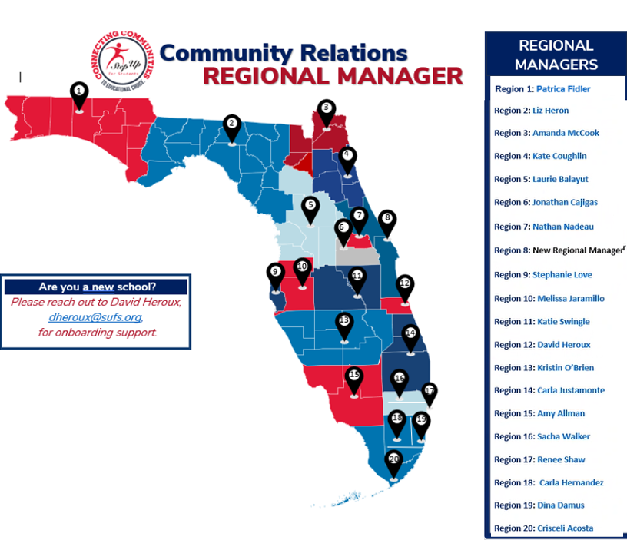
Still have questions?
Lauren May,
Director of Advocacy
Lmay@sufs.org
Notes:
Paula
#8 will begin February, Nathan is covering the territory until then

Slide 16
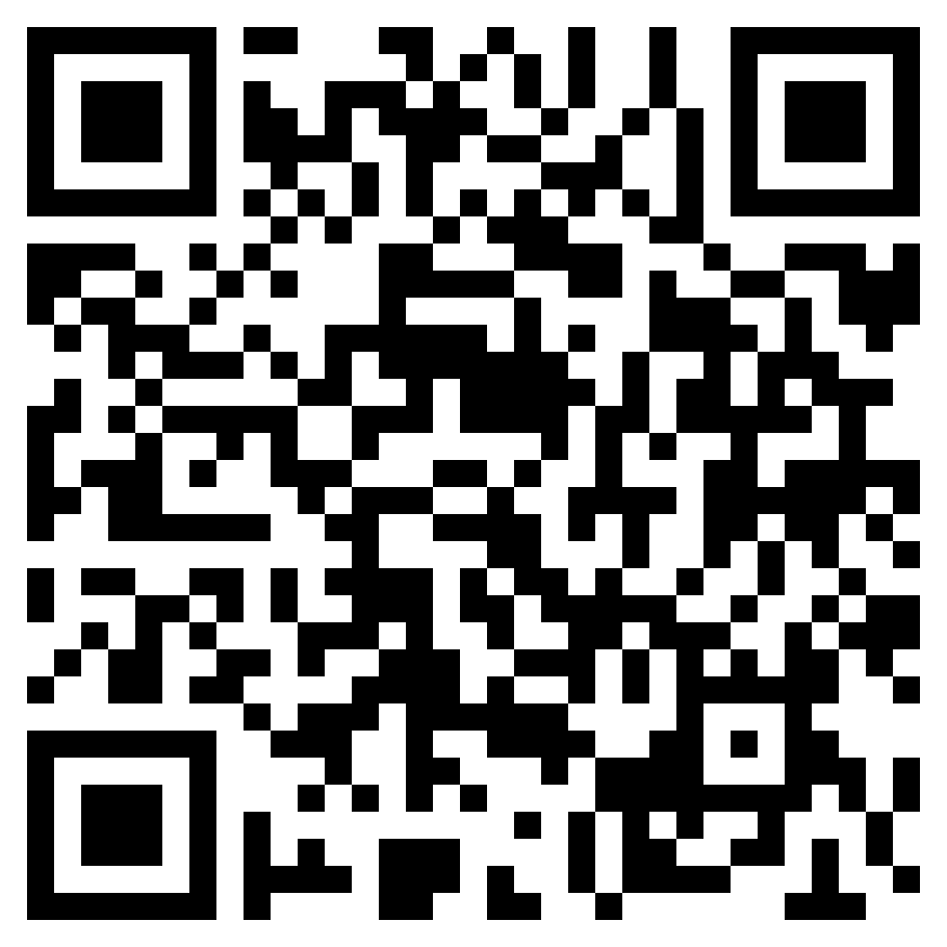
OUR NEXT OFFICE HOURS IS SCHEDULED FOR
May 6th
REMINDER:
OFFICE HOURS WILL BE CONDUCTED AT
10 AM & 4 PM
NEW CADENCE: EVERY 1st THURSDAY
Join Us
To register for future sessions, use the QR code here.

